Slide 1
Introduction to Java Programming
Maharaja Agrasen Institute of Technology
ETCS 307
Java Programming
Lecture 1

Slide 2
ETCS-307 JAVA PROGRAMMING
UNIT I
Overview and characteristics of Java, Java program Compilation and Execution Process Organization of the Java Virtual Machine, JVM as an interpreter and emulator, Instruction Set, class File Format, Verification, Class Area, Java Stack, Heap, Garbage Collection. Security Promises of the JVM, Security Architecture and Security Policy. Class loaders and security aspects, sandbox model
UNIT II
Java Fundamentals, Data Types & Literals Variables, Wrapper Classes, Arrays, Arithmetic Operators, Logical Operators, Control of Flow, Classes and Instances, Class Member Modifiers Anonymous Inner Class Interfaces and Abstract Classes, inheritance, throw and throws clauses, user defined Exceptions, The String Buffer Class, tokenizer, applets, Life cycle of applet and Security concerns.

Slide 3
ETCS-307 JAVA PROGRAMMING
UNIT III
Threads: Creating Threads, Thread Priority, Blocked States, Extending Thread Class, Runnable Interface, Starting Threads, Thread Synchronization, Synchronize Threads, Sync Code Block, Overriding Synced Methods, Thread Communication, wait, notify and notify all. AWT Components, Component Class, Container Class, Layout Manager Interface Default Layouts, Insets and Dimensions, Border Layout, Flow Layout, Grid Layout, Card Layout Grid Bag Layout AWT Events, Event Models, Listeners, Class Listener, Adapters, Action Event Methods Focus Event Key Event, Mouse Events, Window Event
UNIT IV
Input/Output Stream, Stream Filters, Buffered Streams, Data input and Output Stream, Print Stream Random Access File, JDBC (Database connectivity with MS-Access, Oracle, MS-SQL Server), Object serialization, Sockets, development of client Server applications, design of multithreaded server. Remote Method invocation, Java Native interfaces, Development of a JNI based application. Collection API Interfaces, Vector, stack, Hashtable classes, enumerations, set, List, Map, Iterators.

Slide 4
ETCS-307 JAVA PROGRAMMING
Text Books:
[T1] Patrick Naughton and Herbertz Schidt, “Java-2 the complete Reference”, TMH
[T2] Sierra & bates, “Head First Java”, O’Reilly
Reference Books:
[R1] E. Balaguruswamy, “Programming with Java”, TMH
[R2] Horstmann, “Computing Concepts with Java 2 Essentials”, John Wiley.
[R3] Decker & Hirshfield, “Programming.Java”, Vikas Publication.

Slide 5
Contents
Java Introduction
Java Features
How Java Differs from other OO languages
Java and the World Wide Web
Java Environment
Build your first Java Program
General Structure of Java program

Slide 6
Java - An Introduction
Java - The new programming language developed by Sun Microsystems in 1991.
Originally called Oak by James Gosling, one of the inventors of the Java Language.
Java Authors: James , Arthur Van , and others
Java is really “C++ -- ++ “

Slide 7
Java Introduction
Originally created for consumer electronics (TV, VCR, Washing Machine, Mobile Phone).
Java - CPU Independent language
Internet and Web was just emerging, so Sun turned it into a language of Internet Programming.
It allows you to publish a webpage with Java code in it.

Slide 8
Java Milestones
Year | Development
1990 | Sun decided to developed special software that could be used for electronic devices. A project called Green Project created and head by James Gosling.
1991 | Explored possibility of using C++, with some updates announced a new language named “Oak”
1992 | The team demonstrated the application of their new language to control a list of home appliances using a hand held device.
1993 | The World Wide Web appeared on the Internet and transformed the text-based interface to a graphical rich environment. The team developed Web applets (time programs) that could run on all types of computers connected to the Internet.

Slide 9
Java Milestones
Year | Development
1994 | The team developed a new Web browser called “Hot Java” to locate and run Applets. HotJava gained instance success.
1995 | Oak was renamed to Java, as it did not survive “legal” registration. Many companies such as Netscape and Microsoft announced their support for Java.
1996 | Java established itself as both 1. “the language for Internet programming” 2. a general purpose OO language.
1997- | A class libraries, Community effort and standardization, Enterprise Java, Clustering, etc..

Slide 10
Characteristics of Java
Java Is Simple
Java Is Object-Oriented
Java Is Distributed
Java Is Interpreted
Java Is Robust
Java Is Secure
Java Is Architecture-Neutral
Java Is Portable
Java's Performance
Java Is Multithreaded
Java Is Dynamic

Slide 11
Characteristics of Java
Java is partially modeled on C++, but greatly simplified and improved. Some people refer to Java as "C++--++" because it is like C++ but with more functionality and fewer negative aspects.
fixes some clumsy features of C++
no pointers
automatic garbage collection
rich pre-defined class library
Java Is Simple
Java Is Object-Oriented
Java Is Distributed
Java Is Interpreted
Java Is Robust
Java Is Secure
Java Is Architecture-Neutral
Java Is Portable
Java's Performance
Java Is Multithreaded
Java Is Dynamic

Slide 12
Characteristics of Java
Java is inherently object-oriented. Object-oriented programming (OOP) is a popular programming approach that is replacing traditional procedural programming techniques.
One of the central issues in software development is how to reuse code. Object-oriented programming provides great flexibility, modularity, clarity, and reusability through encapsulation, inheritance, and polymorphism.
focus on the data (objects) and methods manipulating the data
all functions are associated with objects
almost all datatypes are objects (files, strings, etc.)
potentially better code organization and reuse
Java Is Simple
Java Is Object-Oriented
Java Is Distributed
Java Is Interpreted
Java Is Robust
Java Is Secure
Java Is Architecture-Neutral
Java Is Portable
Java's Performance
Java Is Multithreaded
Java Is Dynamic

Slide 13
Characteristics of Java
Distributed computing involves several computers working together on a network. Java is designed to make distributed computing easy. Since networking capability is inherently integrated into Java, writing network programs is like sending and receiving data to and from a file.
Java Is Simple
Java Is Object-Oriented
Java Is Distributed
Java Is Interpreted
Java Is Robust
Java Is Secure
Java Is Architecture-Neutral
Java Is Portable
Java's Performance
Java Is Multithreaded
Java Is Dynamic

Slide 14
Characteristics of Java
Java Is Simple
Java Is Object-Oriented
Java Is Distributed
Java Is Interpreted
Java Is Robust
Java Is Secure
Java Is Architecture-Neutral
Java Is Portable
Java's Performance
Java Is Multithreaded
Java Is Dynamic
You need an interpreter to run Java programs. The programs are compiled into the Java Virtual Machine code called bytecode. The bytecode is machine-independent and can run on any machine that has a Java interpreter, which is part of the Java Virtual Machine (JVM).

Slide 15
Characteristics of Java
Java compilers can detect many problems that would first show up at execution time in other languages. It has extensive compile-time and runtime error checking
It has eliminated certain types of error-prone programming constructs found in other languages. There are no pointers. Memory corruptions or unauthorized memory accesses are impossible
Java has a runtime exception-handling feature to provide programming support for robustness.
It has automatic garbage collection tracks objects usage over time
Java Is Simple
Java Is Object-Oriented
Java Is Distributed
Java Is Interpreted
Java Is Robust
Java Is Secure
Java Is Architecture-Neutral
Java Is Portable
Java's Performance
Java Is Multithreaded
Java Is Dynamic

Slide 16
Characteristics of Java
Java Is Simple
Java Is Object-Oriented
Java Is Distributed
Java Is Interpreted
Java Is Robust
Java Is Secure
Java Is Architecture-Neutral
Java Is Portable
Java's Performance
Java Is Multithreaded
Java Is Dynamic
Java implements several security mechanisms to protect your system against harm caused by stray programs.
usage in networked environments requires more security
memory allocation model is a major defense
access restrictions are forced (private, public)

Slide 17
Characteristics of Java
Java Is Simple
Java Is Object-Oriented
Java Is Distributed
Java Is Interpreted
Java Is Robust
Java Is Secure
Java Is Architecture-Neutral
Java Is Portable
Java's Performance
Java Is Multithreaded
Java Is Dynamic
Write once, run anywhere
With a Java Virtual Machine (JVM), you can write one program that will run on any platform.

Slide 18
Characteristics of Java
Java Is Simple
Java Is Object-Oriented
Java Is Distributed
Java Is Interpreted
Java Is Robust
Java Is Secure
Java Is Architecture-Neutral
Java Is Portable
Java's Performance
Java Is Multithreaded
Java Is Dynamic
Because Java is architecture neutral, Java programs are portable. They can be run on any platform without being recompiled.

Slide 19
Characteristics of Java
Java Is Simple
Java Is Object-Oriented
Java Is Distributed
Java Is Interpreted
Java Is Robust
Java Is Secure
Java Is Architecture-Neutral
Java Is Portable
Java's Performance
Java Is Multithreaded
Java Is Dynamic
Java’s performance is very high because of its architecture neutral and portable features.

Slide 20
Characteristics of Java
Java Is Simple
Java Is Object-Oriented
Java Is Distributed
Java Is Interpreted
Java Is Robust
Java Is Secure
Java Is Architecture-Neutral
Java Is Portable
Java's Performance
Java Is Multithreaded
Java Is Dynamic
Multithread programming is smoothly integrated in Java, whereas in other languages you have to call procedures specific to the operating system to enable multithreading.

Slide 21
Characteristics of Java
Java Is Simple
Java Is Object-Oriented
Java Is Distributed
Java Is Interpreted
Java Is Robust
Java Is Secure
Java Is Architecture-Neutral
Java Is Portable
Java's Performance
Java Is Multithreaded
Java Is Dynamic
Java was designed to adapt to an evolving environment. New code can be loaded on the fly without recompilation. There is no need for developers to create, and for users to install, major new software versions. New features can be incorporated transparently as needed.

Slide 22
Java Disadvantages
Slower than compiled language such as C
an experiment in 1999 showed that Java was 3 or 4 times slower than C or C++
title of the article: “Comparing Java vs. C/C++ Efficiency Issues to Interpersonal Issues” (Lutz Prechelt)
Running bytecode through the interpreter is not as fast as running machine code, which is specific to that platform.
Because it is platform independent, it is difficult to use platform specific features (e.g., Windows taskbar, quick launch) in Java.
Java interpreter must be installed on the computer in order to run Java programs.

Slide 23
Compiled Languages
Programmer
Source Code
Object Code
Executable Code
Text Editor
Compiler
linker
.c file
.o/.obj file
a.out file
Notepad, emacs,vi
gcc

Slide 24
Java is Compiled and Interpreted
Programmer
Hardware and
Operating System
Source Code
Byte Code
Text Editor
Compiler
Interpreter
.java file
.class file
Notepad, emacs,vi, textpad,
javac
java
appletviewer
netscape

Slide 25


Java Interpreter
Java is a little different.
Java compiler produces bytecode not machine code.
Bytecode can be run on any computer with the Java interpreter installed.
Win
Interpreter
Java Program
Java Bytecode
MAC
compiler
Interpreter
Interpreter
Unix

Slide 26
Total Platform Independence
JAVA COMPILER
(translator)
JAVA BYTE CODE
(same for all platforms)
JAVA INTERPRETER
(one for each different system)
Windows 95
Macintosh
Solaris
Windows NT

Slide 27
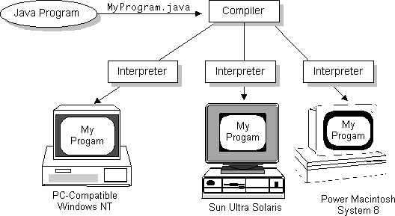
Write Once, Run Anywhere

Slide 28
ByteCode: Food for the VM
For most languages, compilation produces machine code
Java compilation produces “bytecode”
Intermediate code readable by the VM
Transferable across the Internet as applets
VM interprets BC into instructions
Partly responsible for performance lag
ByteCode produced on any platform may be executed on any other platform which supports a VM

Slide 29
Execution Model of Java
compiler
source
(text)
bytecode
(aka. class file)
JVML
dynamic
loading
virtual machine
verifier
JIT
compiler
bytecode
interpreter
compiled
code
CPU

Slide 30
The JIT
Just-In-Time compiler
Translates bytecode into machine code at runtime
1-time overhead when run initiated
Performance increase 10-30 times
Now the default for most JVM’s
Can be turned off if desired
JIT can apply statistical optimizations based on runtime usage profile

Slide 31
Not just one JVM, but a whole family
JVM (J2EE & J2SE)
Well-known Java Virtual Machine.
CVM , KVM (J2ME)
Small devices.
Reduces some VM features to fit resource-constrained devices.
JCVM (Java Card)
Smart cards.
It has least VM features.
and there are also lots of other JVMs

Slide 32
How Does Java Compares to C++ and Other OO Languages

Slide 33
Overlap of C, C++, and Java
C++
C
Java

Slide 34
Difference between Java, C and C++
In a first contact, Java seems like C++, and it's logical because Java takes the C and C++ syntax. But Java has some important differences with C++. For instance, you can't use pointers in Java, neither operators overload, neither multiple inheritance, neither predefined types. These features of C++ that Java doesn't has, make it a simplest and more robust language. Interpreted Java is furthermore slower than C++ (even 20 to 50 times slower than C in the original Java interpreters).
Memory administration: Java memory administration is automatic; memory is assigned automatically when you create an object, and also a garbage collector frees the memory when that object is not used. Functions malloc() and free() don't exist in Java.
Type of data: In Java, Primitive data types (like char, int, long...) have sizes and behaviors which may be different in some platforms and operative systems. In Java language, unsigned data don't exist. The boolean data has two values in Java : true and false. So it isn't an integer type, but you can force "0" and "1" (which are integers) to be booleans.

Slide 35
Difference between Java, C and C++
Operators: The execution order of the operators in Java is same as in C.
Flux Control: The syntax of the following statements if, while, for and do is the same as in C and C++. But there is an important difference : the proof expression for each flux construction should return a boolean value (true or false). In C and C++, the expression can return an integer.
Arguments: In Java all method definitions have to have an specific number of arguments. The arguments in the command line have a different behavior than in C and C++. So, in these languages argv[0] is the name of the program but in Java this is the first of additional arguments.

Slide 36
Java better than C++ ?
No Typedefs, Defines, or Preprocessor
No Global Variables
No Goto statements
No Pointers
No Unsafe Structures
No Multiple Inheritance
No Operator Overloading
No Automatic Coercions
No Fragile Data Types

Slide 37
Object Oriented Languages -A Comparison

Slide 38
Java Integrates
Power of Compiled Languages
and
Flexibility of Interpreted Languages

Slide 39
Java Applications
We can develop two types of Java programs:
Stand-alone applications
Web applications (applets)

Slide 40
Applications v/s Applets
Different ways to run a Java executable are:
Application- A stand-alone program that can be invoked from command line . A program that has a “main” method
Applet- A program embedded in a web page , to be run when the page is browsed . A program that contains no “main” method
Application –Executed by the Java interpreter.
Applet- Java enabled web browser.

Slide 41
Java and World Wide Web
Turning the Web into an Interactive and Application Delivery Platform

Slide 42
What is World Wide Web ?
Web is an open-ended information retrieval system designed to be used in the Internet wide distributed system.
It contains Web pages (created using HTML) that provide both information and controls.
Unlike a menu driven system--where we are guided through a particular direction using a decision tree, the web system is open ended and we can navigate to a new document in any direction.

Slide 43
Web Structure of Information Search/Navigation

Slide 44
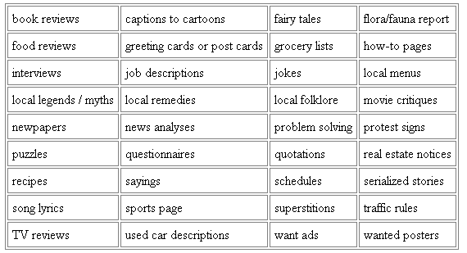
Web as a delivery Vehicle

Slide 45
Execution of Applets
1
2
3
4
5
APPLET Development “hello.java”
AT
SUN.COM
hello.class
AT SUN’S
WEB SERVER
Create Applet
tag in HTML
document
Accessing
from
Unimelb.edu.au
The browser creates
a new window and
a new thread and
then runs the code
Hello Java
<app=
“Hello”>
The Internet
Hello

Slide 46
Significance of downloading Applets
Interactive WWW
Flashy animation instead of static web pages
Applets react to users input and dynamically change
Display of dynamic data
WWW with Java - more than a document publishing medium

Slide 47
Java Environment

Slide 48
Java Development Kit
javac - The Java Compiler
java - The Java Interpreter
jdb- The Java Debugger
appletviewer -Tool to run the applets
javap - to print the Java bytecodes
javaprof - Java profiler
javadoc - documentation generator
javah - creates C header files

Slide 49
Process of Building and Running Java Programs
Text Editor
Java Source Code
javadoc
HTML Files
javac
Java Class File
javah
Header Files
java
jdb
Outout

Slide 50

Java VM and API
Java API and Virtual Machine insulate the Java program from hardware dependencies.
Java API

Slide 51
Java API
Collection of ready-made software components that provide many useful capabilities.
Grouped into libraries (packages) of related components.
Core API
Essentials: Object, String, Input and Output...
Applets
Networking
Internationalization
Security
Software Components
Object Serialization
Java Database Connectivity (JDBC)

Slide 52
Building your first Java Program

Slide 53
The “Hello World” Application

Slide 54
Create a Java Source File
public class HelloWorld { public static void main(String[] args) { System.out.println("Hello World!"); }
}

Slide 55
Compile and Run
Compile
javac HelloWorld.java
One file named HelloWorld.class is created if the compilation succeeds.
Run
java HelloWorld

Slide 56
The Simplest Java Application: Hello,World!
Since Java is object-oriented, programs are organized into modules called classes, which may have data in variables and subroutines called methods.
Each program is enclosed in a class definition.
main() is the first method that is run.
class HelloWorld
{ public static void main (String[] args)
{ System.out.println(“Hello World!”);
}
}
The notation class.method or package.class.method is how to refer to a public method (with some exceptions).
Syntax is similar to C - braces for blocks, semicolon after each statement. One difference: upper and lower case matter!
Notes:
32

Slide 57
Understanding first java program
class keyword is used to declare a class in java.
public keyword is an access modifier which represents visibility, it means it is visible to all.
static is a keyword, if we declare any method as static, it is known as static method. The core advantage of static method is that there is no need to create object to invoke the static method. The main method is executed by the JVM, so it doesn't require to create object to invoke the main method. So it saves memory.
void is the return type of the method, it means it doesn't return any value.
main represents startup of the program.
String[] args is used for command line argument.
System.out.println() is used print statement.
Notes:
32

Slide 58
The “Hello World” Applet

Slide 59
Create a Java Source File HelloWorldApplet.java
import java.applet.Applet; import java.awt.Graphics; public class HelloWorldApplet extends Applet { public void paint(Graphics g) { g.drawString(“Hello World!”, 5, 25); } }

Slide 60
Compile the Source File
javac HelloWorldApplet.java
One file named HelloWorldApplet.class is created if the compilation succeeds.

Slide 61
Displaying your applet from a Web page.
Create an HTML file with an applet tag to display the results of drawing the applet.
<html><head>
<title>Simple Hello Page</title>
</head>
<body>
My Java applet says:
<applet code=“HelloWorldApplet.class” width=500 height=500>
</applet>
</body></html>
Name of your applet class.
The browser will use a rectangle of width 500 pixels and height 500 pixels to display the applet within the other html.
Notes:
36

Slide 62
The Simplest Java Applet: Hello, World!
Java applets are part of the class hierarchy that can call methods to display on a screen (within the browser window). One way to draw on the screen is to call the method drawString from the standard method paint.
The import statement allows the use of methods from the Graphics class without the dot notation .
import java.awt.Graphics;
public class HelloWorldApplet extends java.applet.Applet
{ public void paint (Graphics g)
{ g.drawString(“Hello World!”, 5, 25);
}
}
Puts this as a subclass of Applet.
The paint method displays a graphics object on the screen - one of the standard methods that takes the place of main for applets.
Notes:
35

Slide 63
No main method
Yes, applets have a main method...
...but it's in the browser, not in your code!
More about that later in the course …

Slide 64
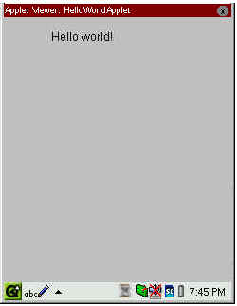
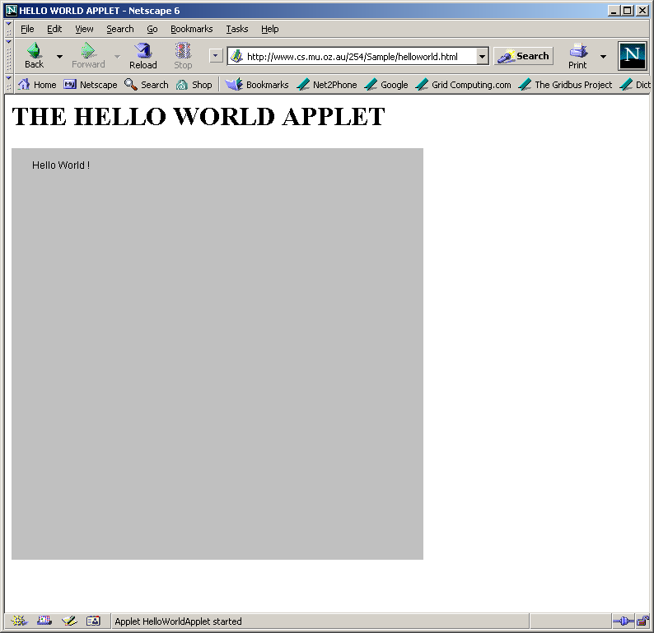
Applet Execution
Using AppletViewer
Using Browser

Slide 65
General Structure of Java program
Document Section
Package Statement
Import Statement
Interface Statements
Class Definition
Main Method Class { Main Method Definition }
Suggested
Optional
Optional
Optional
Optional
Essential

Slide 66
Thank You

